Slide 1

Using Azure to Create Cloud-Enabled Mobile Apps
Matthew Leibowitz
Software Engineer @ Microsoft
@mattleibow
maleib@microsoft.com

Slide 2
Agenda
What is Xamarin?
Xamarin & .NET
Under the Hood
Tooling & Integrations
Xamarin in Visual Studio

Slide 3







Your platform for building anything
Desktop
Web
Cloud
Mobile
Gaming
IoT
AI
.NET
Notes:
So that is how Xamarin as part of the .NET platform enables you to reach even more platforms than ever and share code between all of your apps.

Slide 4




Essentials for mobile success
Beautiful native apps
Build, test, distribute, learn
Intelligent cloud

Slide 5





+
Visual Studio and Xamarin
The Best Way to Build Cloud-Connected Mobile Apps

Slide 6










.NET cloud apps run best in Azure
Azure Storage
Azure Cosmos DB
Azure App Service
Azure Functions
Azure App Insights
Azure Service Fabric
Azure SignalR Service
Azure Virtual Machines
Azure SQL Database
Azure Cognitive Services
Azure Kubernetes Service (AKS)
And many more…
Extend apps with serverless, event driven tasks
Commoditized AI
Fully managed platform perfect for running .NET Framework and .NET Core web apps and services
Application performance and usability monitoring
Build native .NET, fully managed, scalable microservices
Relational Database
Non-Relational Database
Fully managed real-time web functions, like chat, gaming, tickers, collaboration and more
Store anything. Great for binaries
Container orchestrator for Linux workloads (.NET Core)
Notes:
No matter what you may need, there is a service in Azure for you. From serverless compute with Functions to realtime communication with SignalR, or databases with SQL and Cosmos DB there are great cross-platform SDKs for .NET.

Slide 7
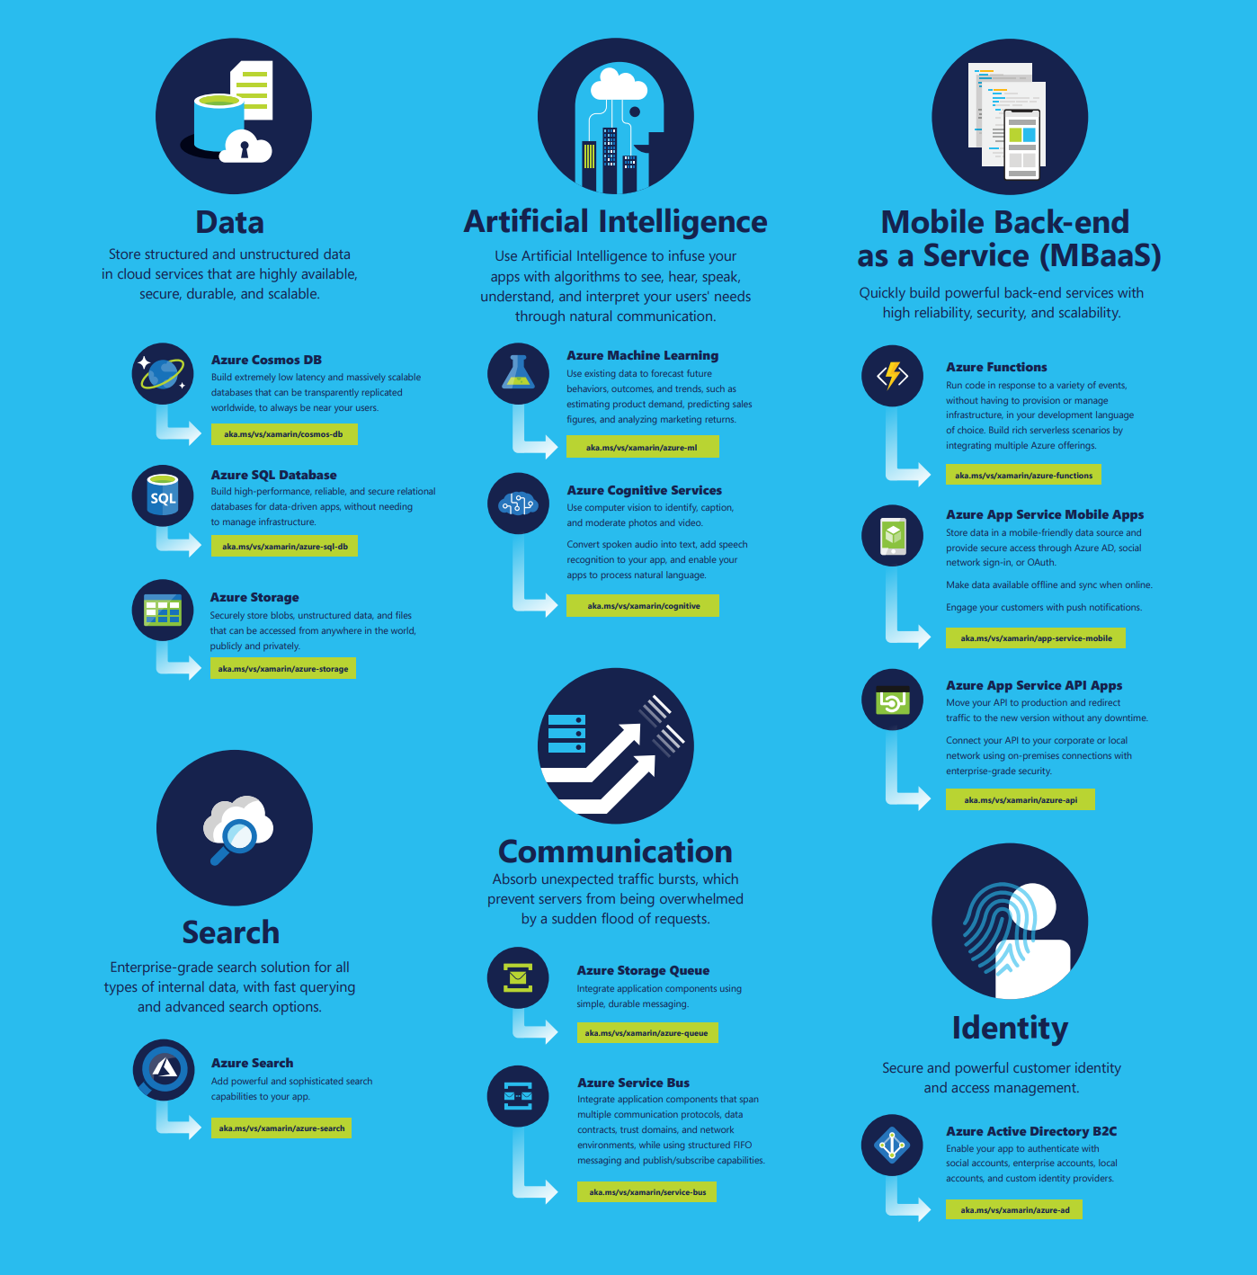

Slide 13

Authentication

Slide 14

Azure Active Directory
Seamless, secure identity, and access management
Multi-factor Auth
Cross-platform SDK

Slide 15

Azure Active Directory B2C
Use social, email, and custom IdPs
Customizable white label solution
Multi-Factor Authentication
Cross-platform SDK

Slide 16
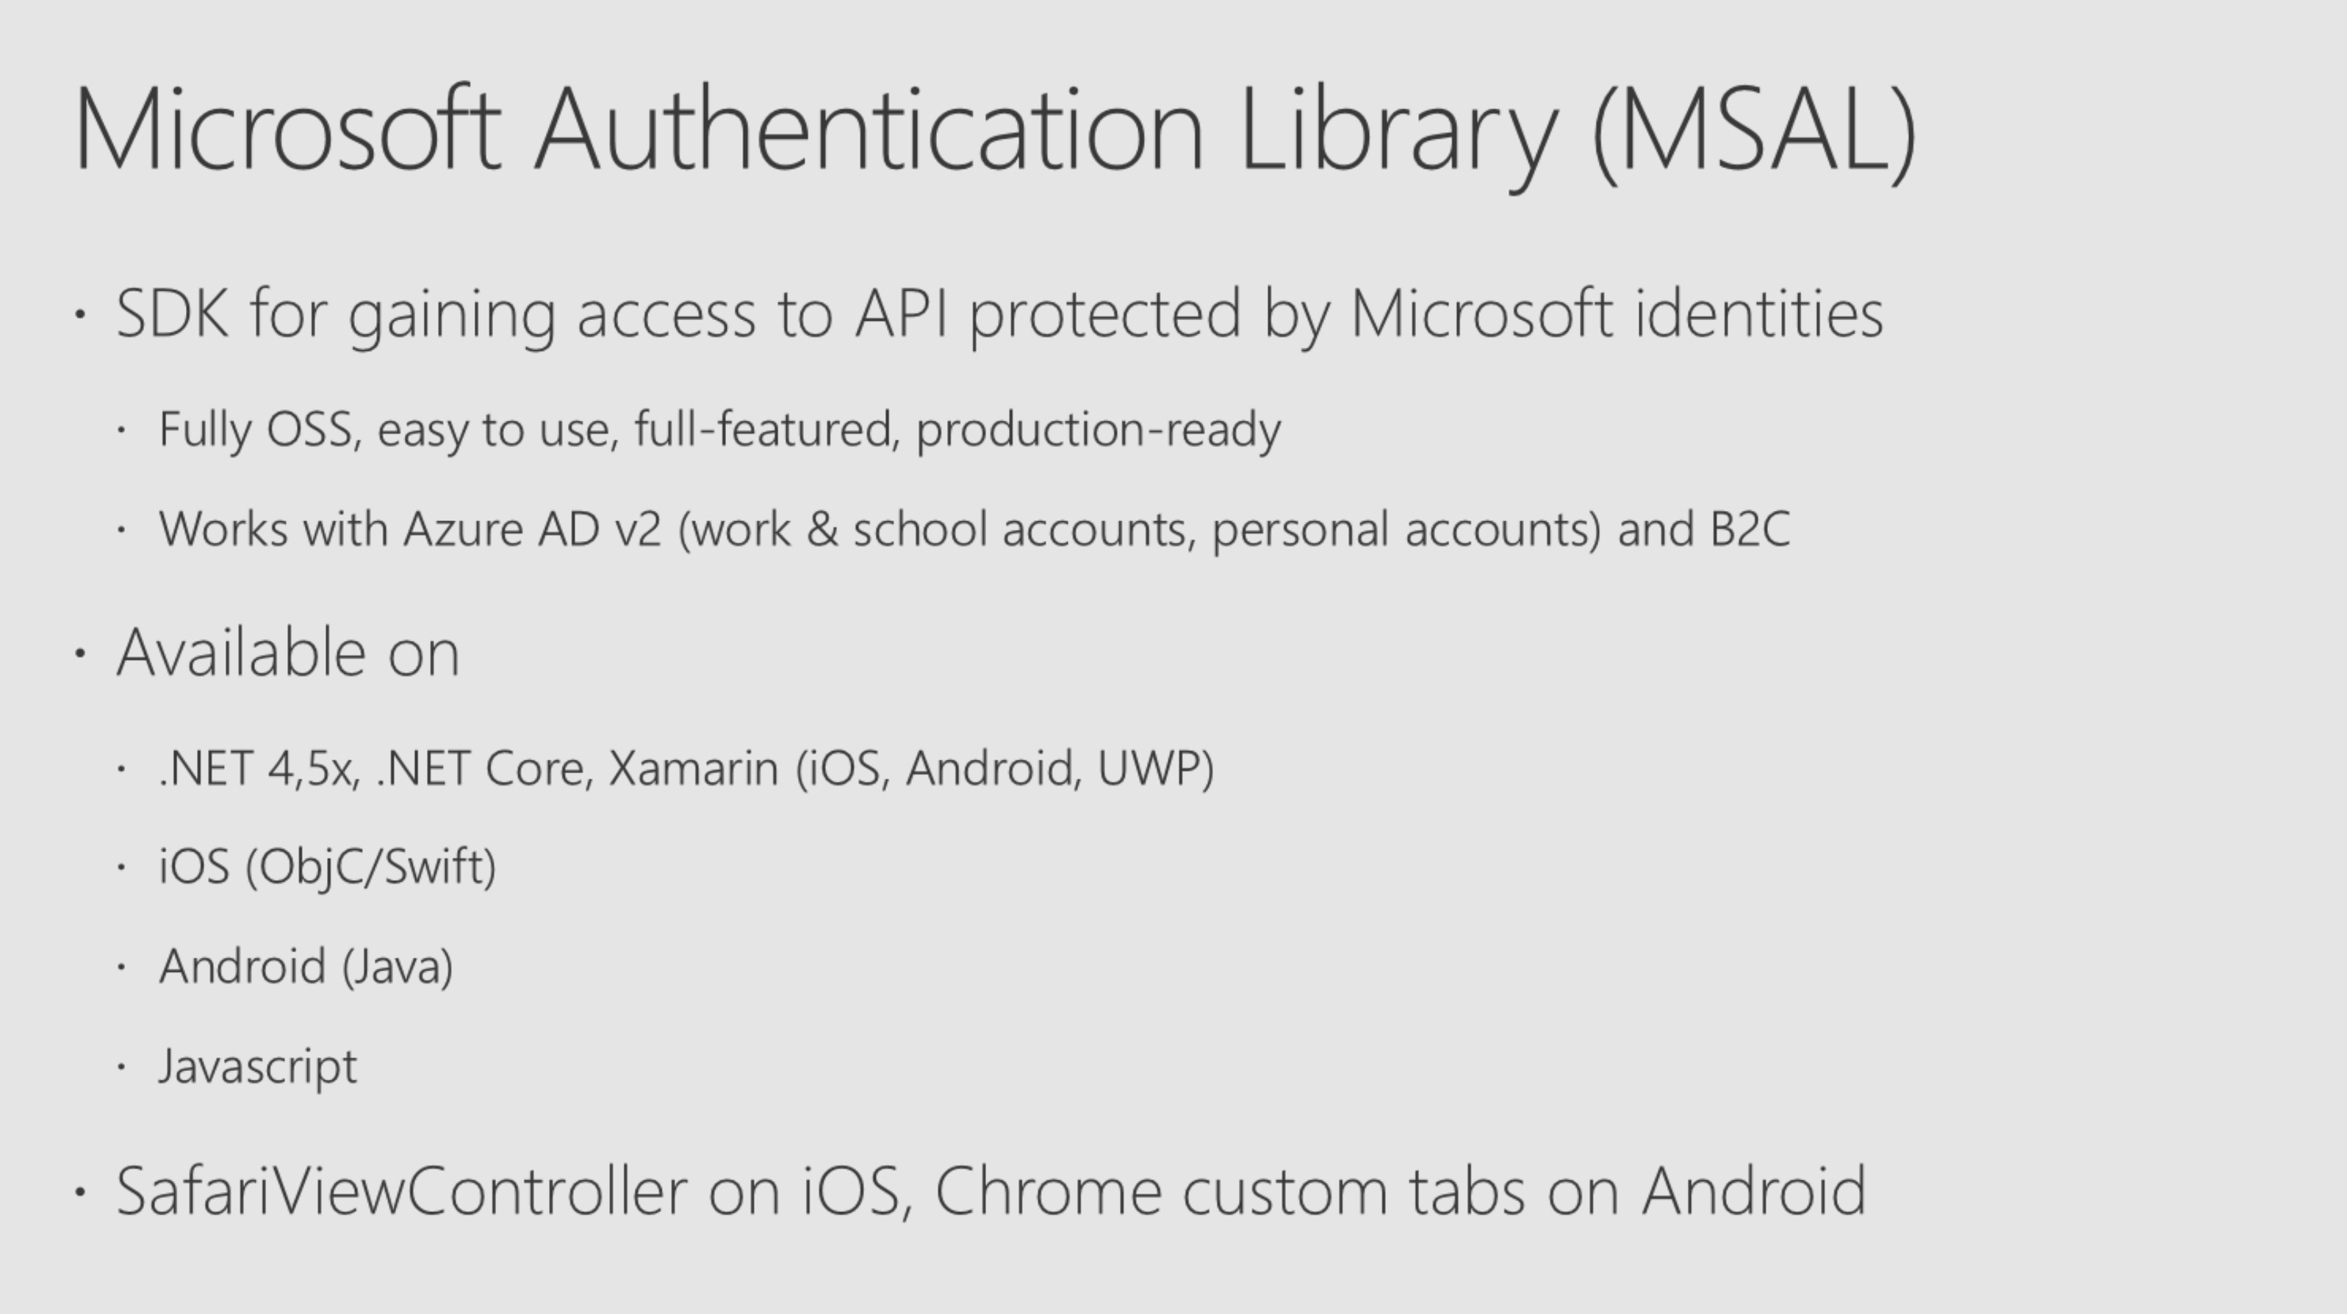

Slide 17
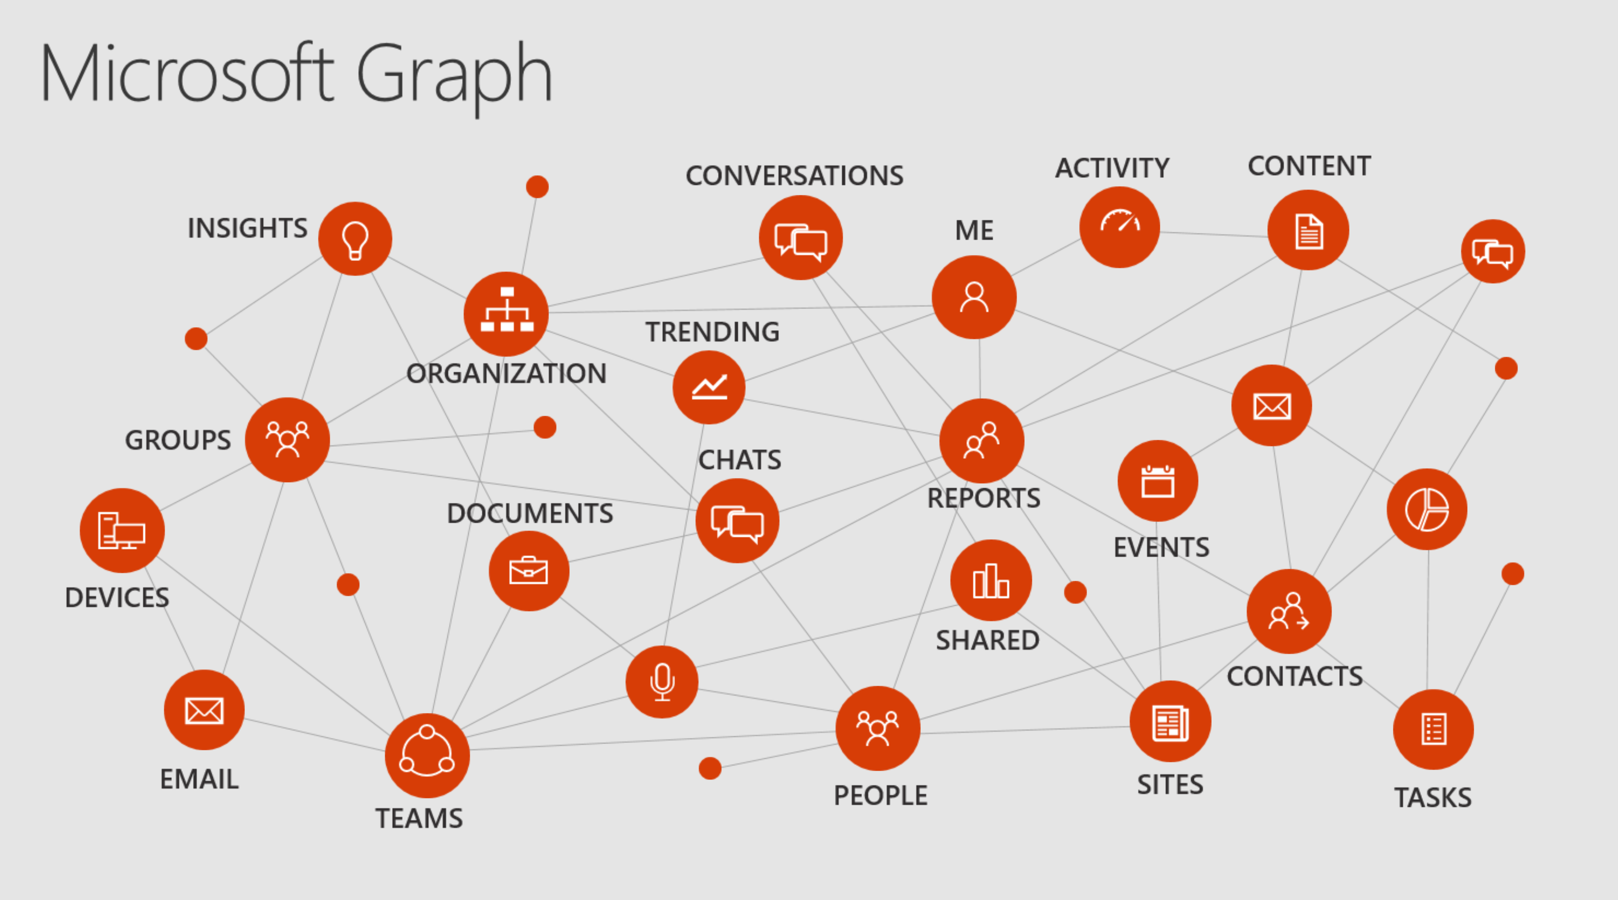

Slide 18

Data

Slide 19
SQL Server 2017
SQL Server 2017
Run on Windows Server, Linux, Docker
Industry leading performance with adaptive query processing
In-database advanced Machine Learning with R and Python

Slide 20
SQL DB
Azure SQL Database
SQL Server as a Service
Highly available, durable, secure, fault tolerant—built-in
Intelligence built-in for auto-tuning and threat detection

Slide 21

Azure Cosmos DB
The first globally distributed, multi-model database service

Slide 22

Azure Cosmos DB
Globally distributed database service

Slide 23

Azure Cosmos DB
Scale to any need
Gigabytes of data
Petabytes of data
Hundreds transactions / second
Millions of transactions / second

Slide 24
Azure Cosmos DB
Only database with comprehensive SLAs across 4 dimensions
Microsoft Azure
High Availability
Performance Latency
Performance Throughput
Data Consistency

Slide 25
Azure Cosmos DB APIs
MongoDB
DocumentDB
Table storage
Gremlin Graph
Spark
Cassandra

Slide 26

Intelligent Apps

Slide 27





Azure SQL Data Warehouse
Azure Cosmos DB
Azure SQL DB
Data-driven Intelligence
Azure Machine Learning
Azure Cognitive Services
Azure Bot Service

Slide 28
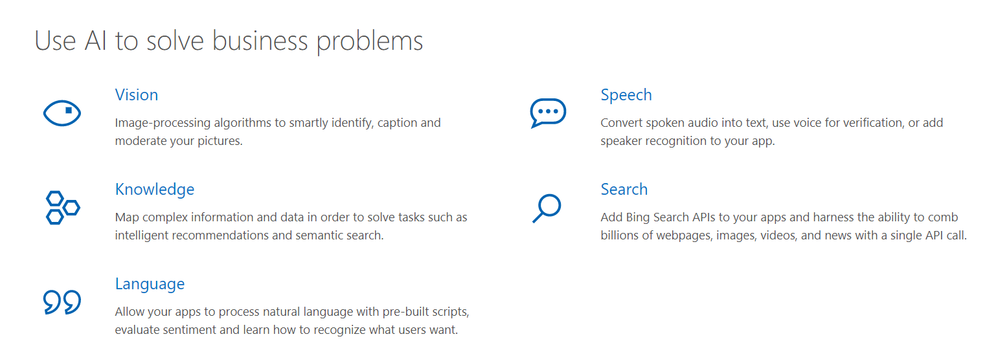
Cognitive Services

Slide 29

Serverless

Slide 30

Azure Functions
Event-driven compute
Scale on demand
Pay only for what you consume
Develop & Debug Locally
Great for mobile apps!

Slide 31
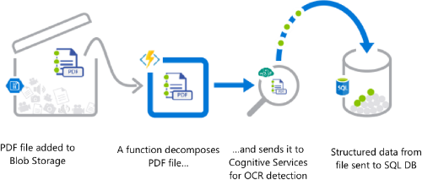
Functions Scenarios

Slide 32
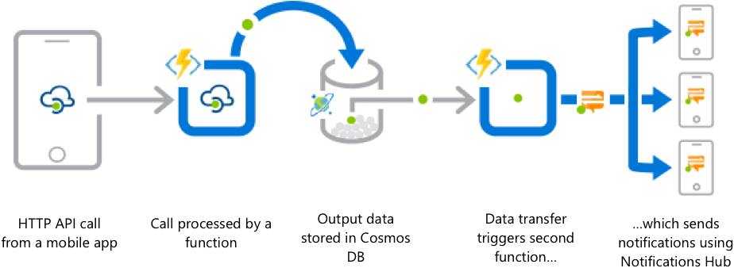
Functions Scenarios

Slide 33
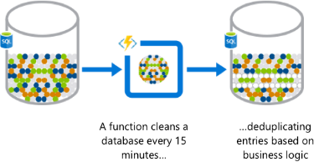
Functions Scenarios

Slide 34
Loved by Developers, Trusted by Enterprises

Slide 35


Slide 36

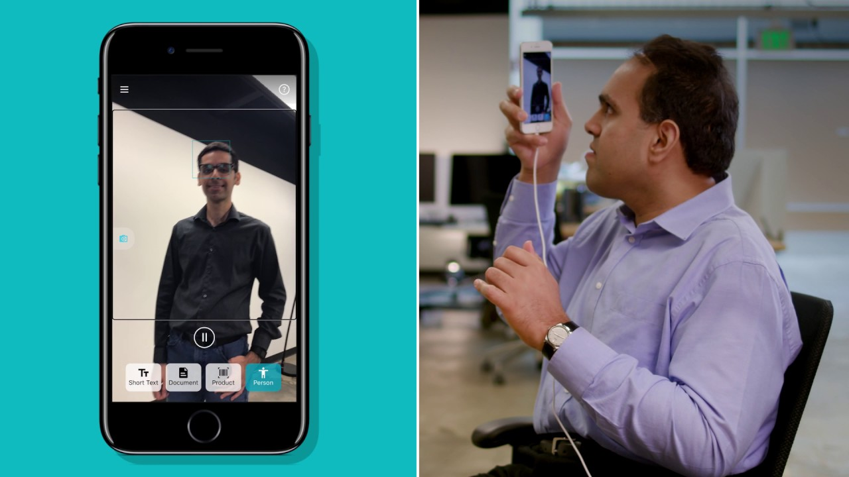

Slide 37
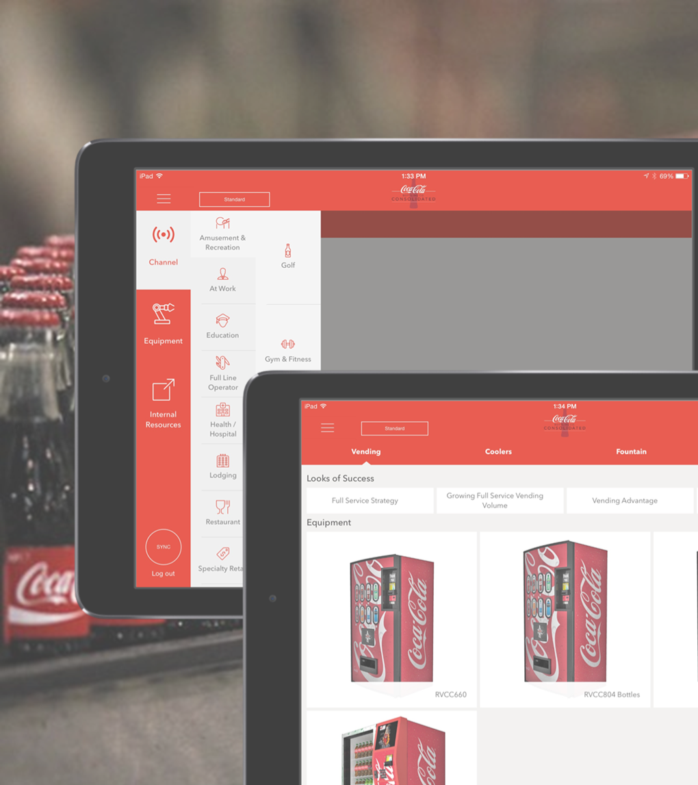

Coca-Cola Bottling Co. Consolidated
Coca-Cola Bottling Co. Consolidated is the largest independent Coca-Cola bottling distributor in the US, with over $1.5 billion in annual revenue. The field sales teams use iPads, equipped with the Marketplace Xamarin app, to help them sell more Coke products and create awareness around various incentive programs.
Streamlined DevOps across distributed teams with Visual Studio, Xamarin, Azure, and Visual Studio Team Services
Enables productivity from remote locations or with limited connectivity at customer sites with Azure sync
Leveraged in-house .NET skills to ship apps in 4 months
Available on
Notes:
App Use Case: B2E
Products: Xamarin for Visual Studio, Azure, VSTS
Business Challenge: Coca-Cola Bottling Co. Consolidated needed to equip its field sales staff to drive more revenue and repeat customers, allowing them customize sales proposals for every customers’ unique needs from anywhere – including areas with extremely limited connectivity.
Talking Points:
Coca-Cola Bottling has revolutionized how their salesforce operates in the field with end-to-end mobile DevOps.
Before, Coca-Cola Bottling Co. sales reps had to sort through bulky, multi-page PDF catalogs for sales conversations. As they spend 80% of their days in the field, sales reps didn’t have time send manual orders for approval until the very end of their day or workweek, losing precious momentum with their customers. Additionally, these reps are often visiting rural areas with spotty internet connections, making it nearly impossible to access mobile information.
But with the help of Microsoft and Xamarin, Coca-Cola Bottling Co. has transformed their sales process. Using a combination of Xamarin for Visual Studio, Azure, Visual Studio Team Services, its development team created a dynamic, customizable field sales app, equipping sellers with real-time customer details and product information. They don’t have to worry about connectivity, as their data is immediately synced in any offline situation and reported when they return to a service area. Coca-Cola Bottling Co.’s more than 1,000 sales representatives are able to stay in the field and make more sales – while turning contracts around at the touch of a finger.

Slide 38
+
Visual Studio and Xamarin
The Best Way to Build Cloud-Connected Mobile Apps

Slide 39
Your platform for building anything
Desktop
Web
Cloud
Mobile
Gaming
IoT
AI
.NET
Notes:
So that is how Xamarin as part of the .NET platform enables you to reach even more platforms than ever and share code between all of your apps.

Slide 40
Get started today
azure.com

Slide 41
Thank you.
Matthew Leibowitz
Software Engineer @ Microsoft
maleib@microsoft.com
dotnetdevaddict.co.za
@mattleibow

